Slide 1

Note
Madeup Bicycles.
This is the final capstone case study for my Google Data Analytics course.
Since public purchase information regarding bicycles are not readily available, I went through Kaggle to find a dataset that best represents what a customer/potential customer profile list would look like.
( https://www.kaggle.com/datasets/heeraldedhia/bike-buyers )
In this case study I have made up a company called “Madeup Bicycles.” with the following logo:

Slide 2

Madeup Bicycles.
Proposal for Targeted Ad.
Bin Bin Huang.
Last Updated: September 13, 2022.

Slide 3

Madeup Bicycles.
Table of Contents.
Targeted Ad.
Overview.
Dataset.
Cleaning the Dataset.
Conclusion.
Proposal.

Slide 4
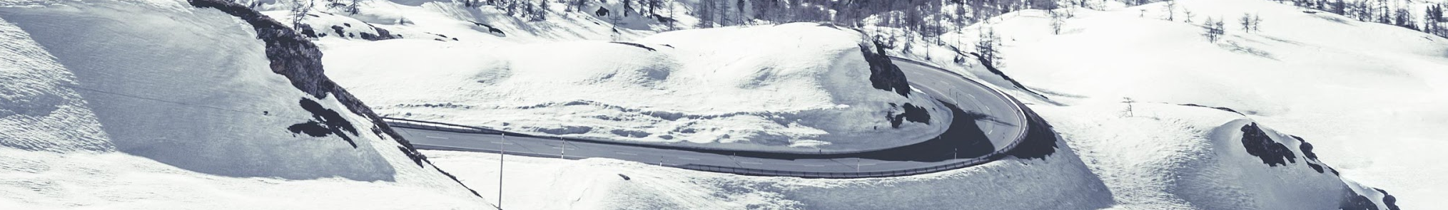
Madeup Bicycles.
Overview.
Madeup Bicycle is developing a targeted ad for an additional equipment subscription service. Madeup Bicycle wants to come up with one user they can put their ad as relatable. This user is the targeted audience who is mostly to purchase this service.
Madeup Bicycle operates globally and have provided a dataset with 1000 of their last customers who registered an account on their website.
We can use a data-driven solution to look for a user group who are consistent across the board in purchasing bicycles to create a targeted ad for.

Slide 5
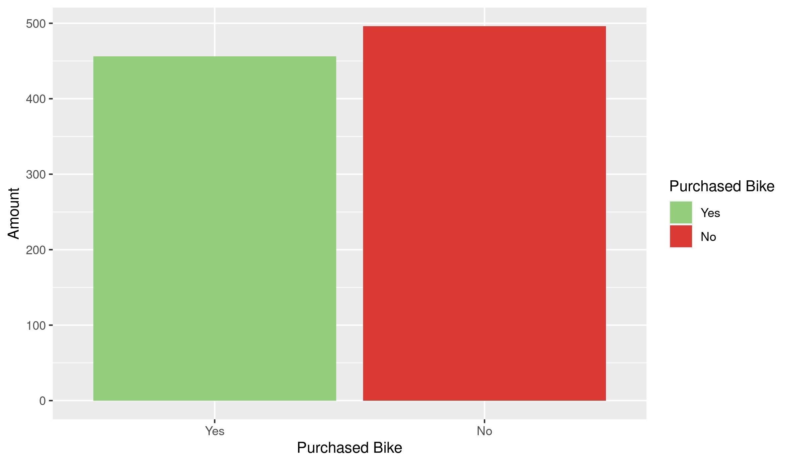
Madeup Bicycles.
Cleaned list of bicycle purchaser
Dataset.
Link: bicycle_buyers.csv
Rows: 1001
Colnames
ID
Marital Status
Gender
Income
Children
Education
Occupation
Home Owner
Cars
Commute Distance
Region
Purchased Bike

Slide 6
Madeup Bicycles
Cleaning the dataset.
.
.
.
.
.
.
.
.
All of the following data cleaning was done on RStudio:
First thing I did was to make sure the chart is correctly formatted. Fortunately, the naming convention is consistent, the values are correctly formatted and only a few rows are missing value.
Then I used a simple R function to remove NA values so we are not getting NA as a bar in our bar graph. This reduced the total rows from 1000 to 952 rows which is not too many lost.
Then I ordered the 3 following columns so the charts will come out in order: Purchased Bike(Yes first, then no), Commute Distance, and Education.
Finally I renamed North America to Americas to align with the rest of the naming region. Since there is no South America data, we do not have to rename those.
Cleaned Data: 1001 Rows -> 952 rows
Added column: Income Level
Income Level - Income Level was added so we can easily create a bar-graph based on 3 income levels: Lower(49,999-), Middle(50,000- 99,999) and Upper(100,000+)
Cleaned CSV: Cleaned_Bicycle.csv

Slide 7
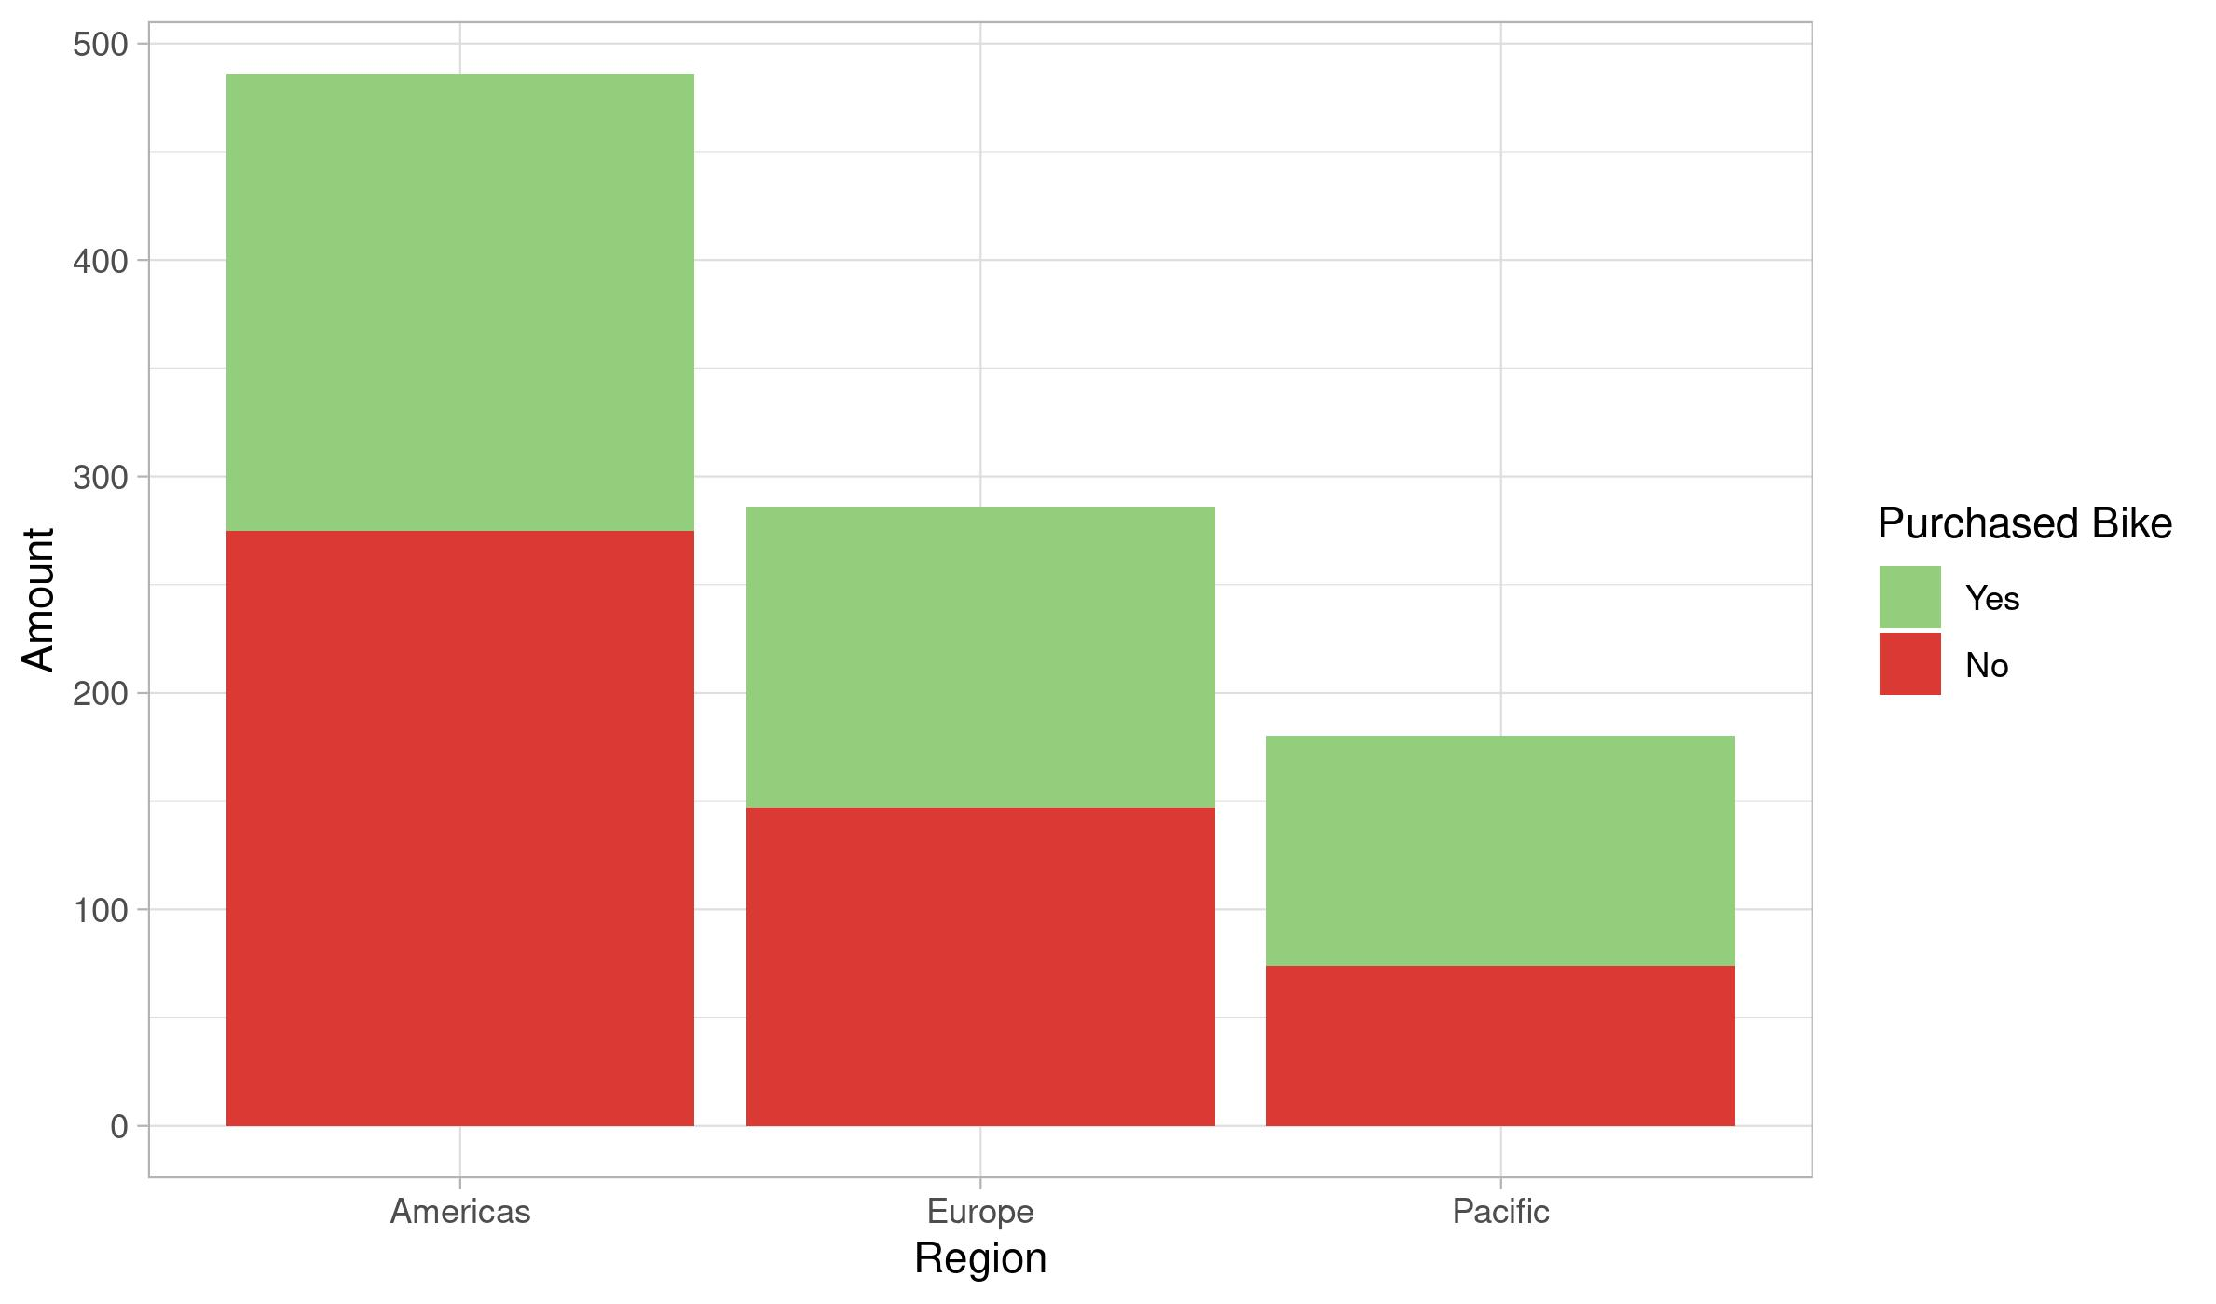
Madeup Bicycles.
Bicycle purchaser based on Region
Conclusion.
Between the three regions, registered Pacific users are most likely to purchase a bike but has the lowest amount of users.
Americas has the most user but is the least likely to purchase a bike after registering an account.
Europe is splitted half and half

Slide 8
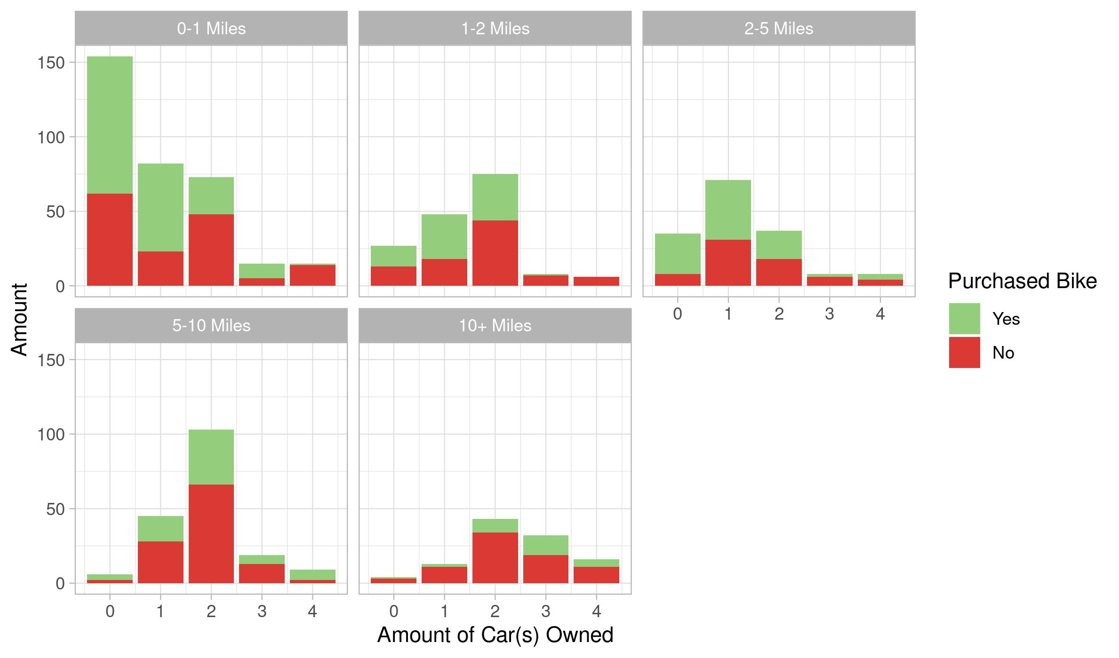
Madeup Bicycles.
Bicycle purchaser based on distance commuted & cars owned
Conclusion.
People with 0-1 cars are more likely to purchase bikes.
For people with the highest commute distance of 10+ miles, they are less likely to own bikes across the board but show signs of owning bikes the more cars they own.

Slide 9
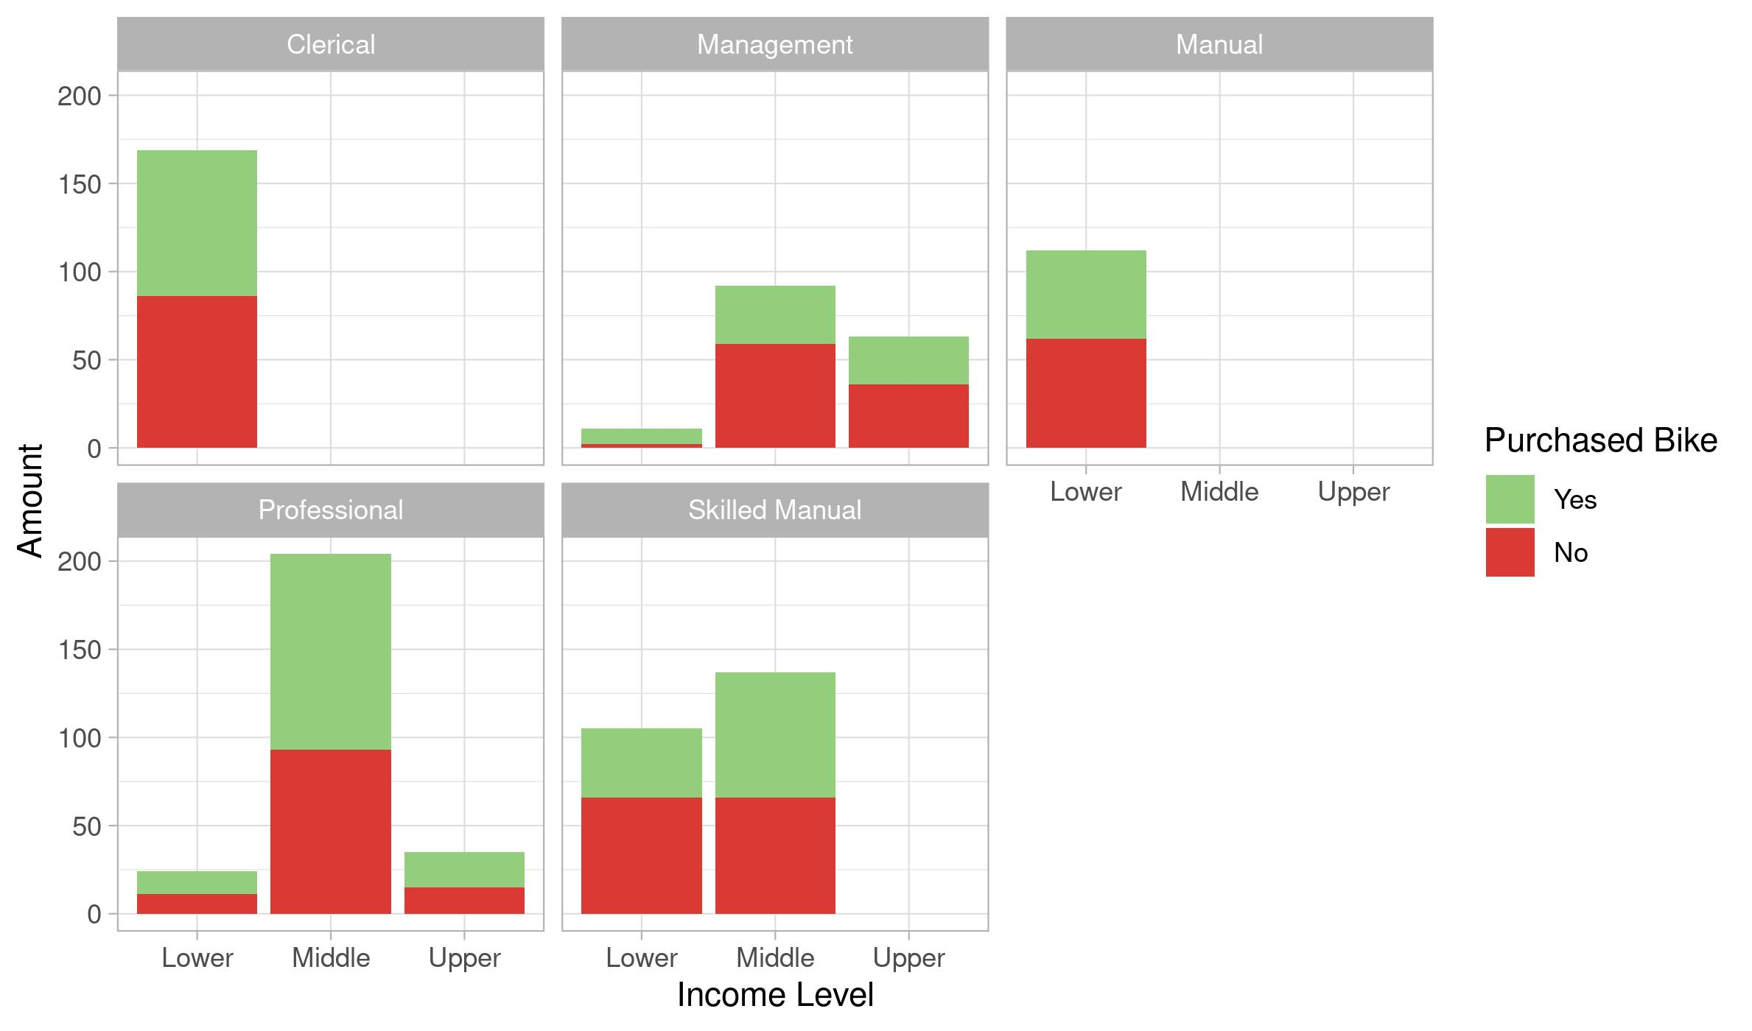
Madeup Bicycles.
Bike purchaser based on profession and income level
Conclusion.
We find that professionals and clerical professions are most likely to own bikes across all income level.

Slide 10
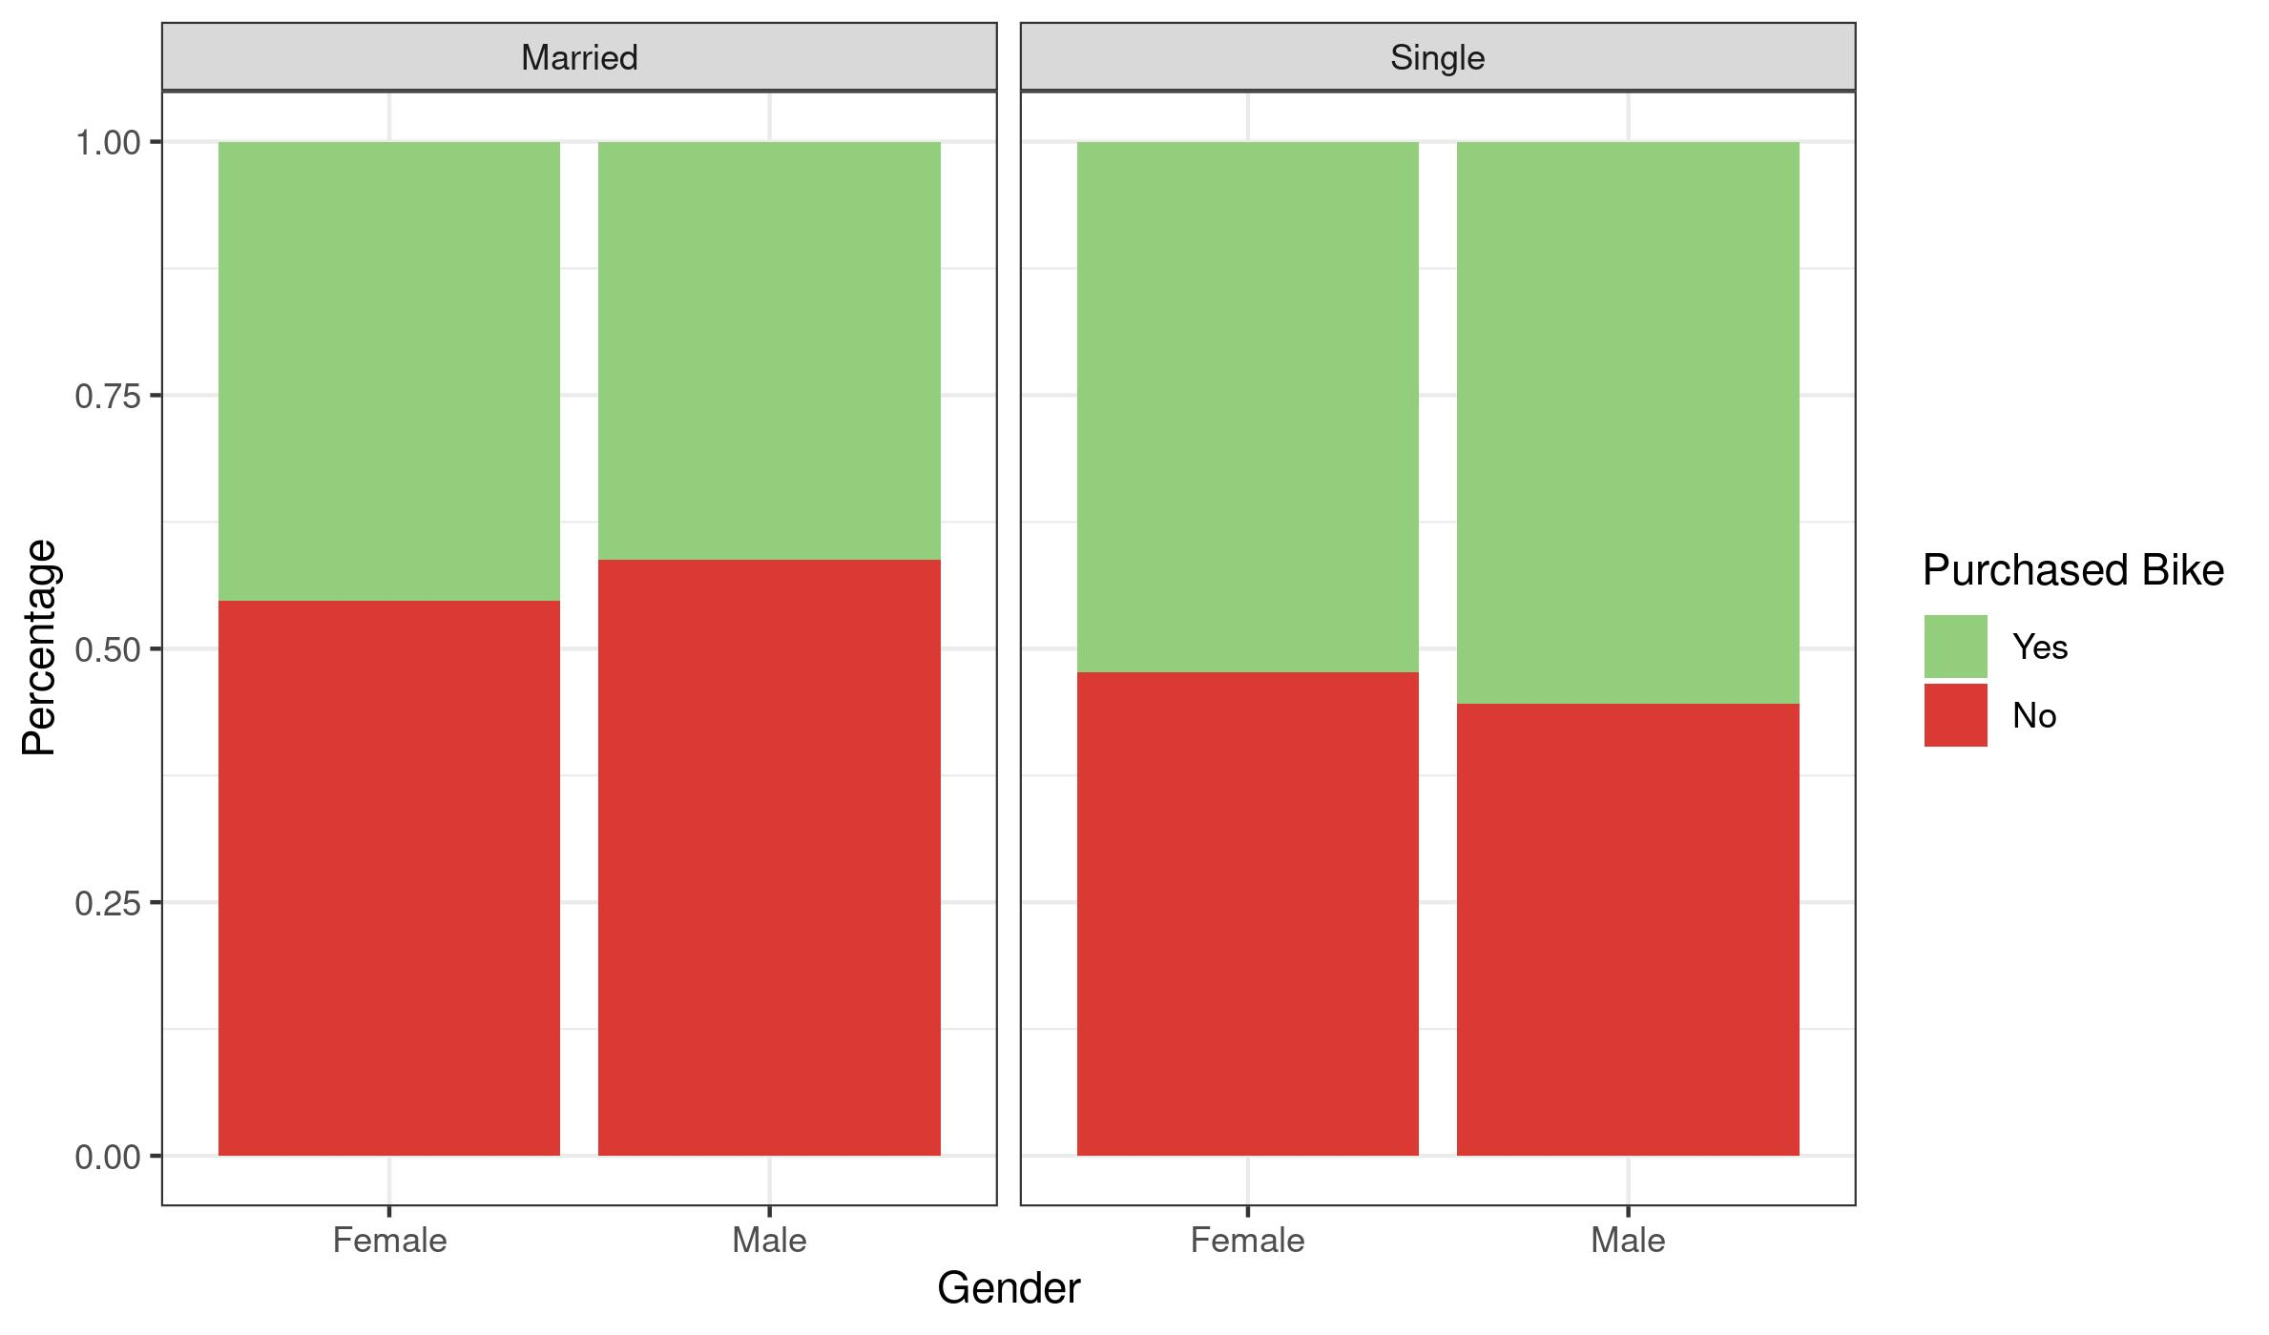
Madeup Bicycles.
Bike purchaser based on marital status and gender
Conclusion.
There is only a few percentage different but a single person is most likely to purchase a bike.
The gender only affects a few percentage change so it does not play a big role.

Slide 11
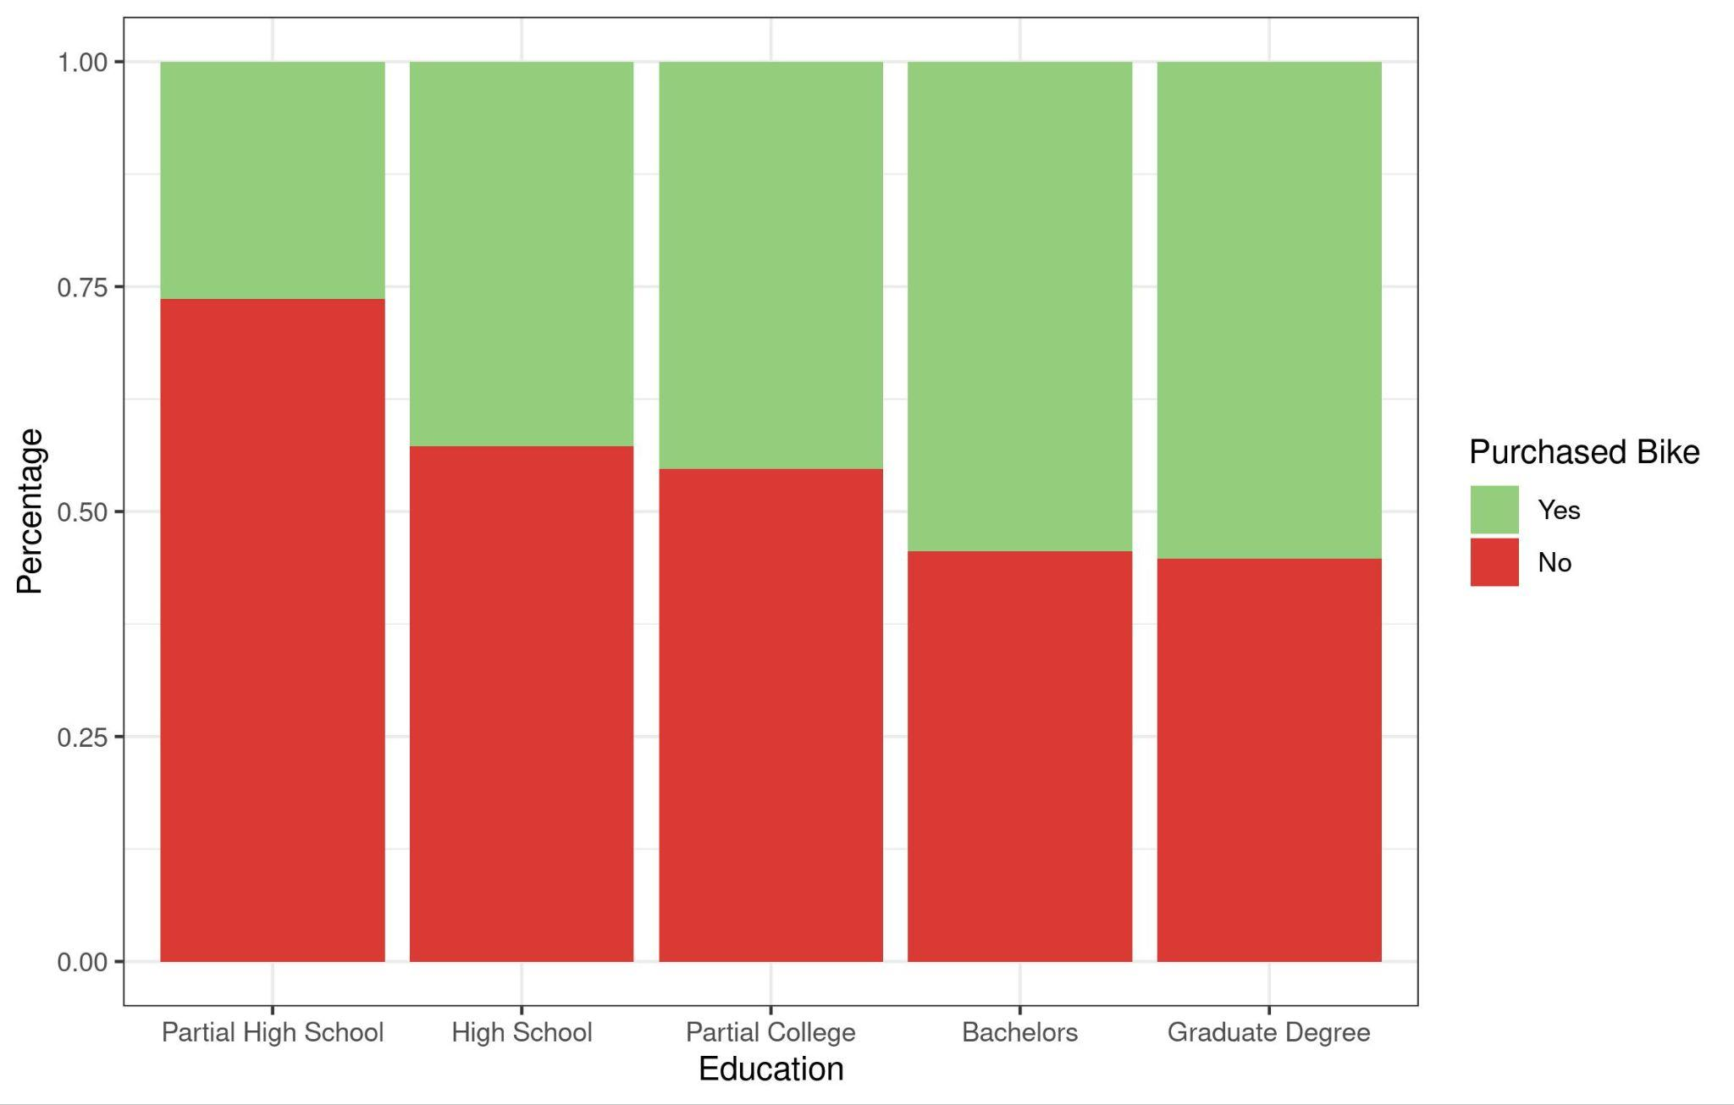
Madeup Bicycles.
Bike purchaser based on education level
Conclusion.
The higher education level someone has, the more likely they are to own a bike.

Slide 12
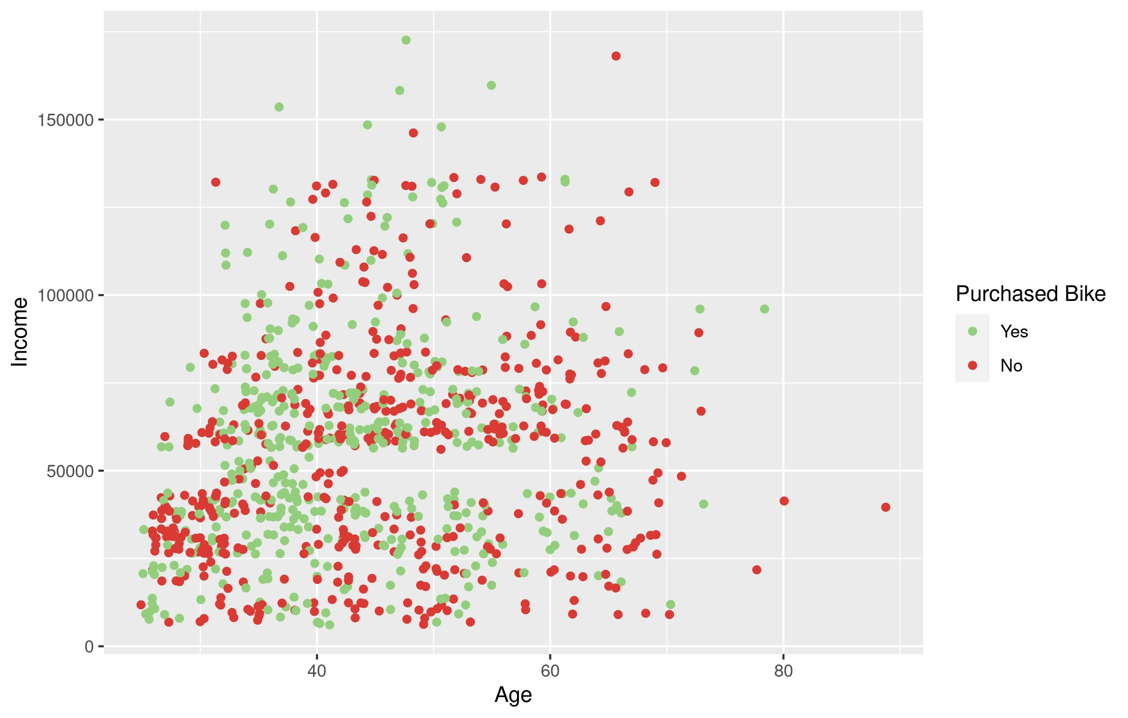
Madeup Bicycles.
Bike purchaser based age and income
Conclusion.
Someone between 20-40 is most likely to own a bike across all income level.
Age 40-60 has a pretty even split .
All other ages are less likely to own a bike.

Slide 13

Madeup Bicycles.
Proposal.
Based on our findings, we can create a targeted ad for a user with the following profile:
Car Ownership: Owns one or no cars.
Marital Status: Slightly leaning towards a single user but a married couple also works.
Education Level: Bachelor's or Graduate degree.
Age: Young adult(s) between 20 and 40 years old.

Slide 14
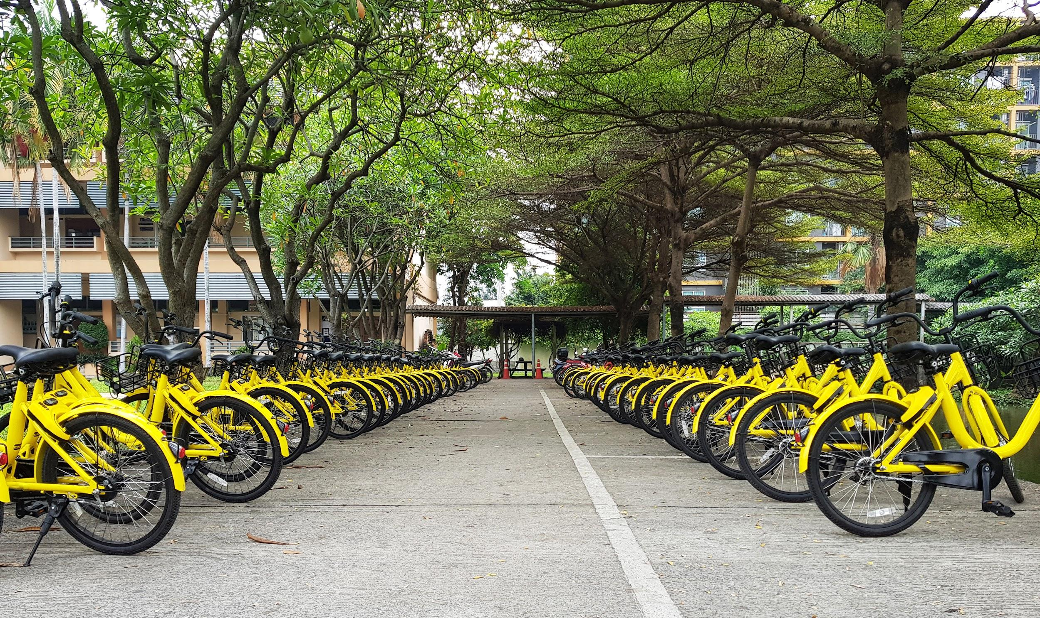
Madeup Bicycles.
Thank you

